Slide 1
Antibiotic sensitivity test(AST) interpretation- As an ID Physician
Dr. Ariful Basher
MBBS, MpH
FCPS (Internal Medicine), FCPS (Infectious & Tropical Diseases)
MD (Critical Care)
Senior Consultant, Infectious Diseases Hospital
Dhaka, Bangladesh
General Secretary, Bangladesh Society of Infectious & Tropical Diseases (BSITD)
https://scholar.google.com/citations?user=h4dIr0sAAAAJ&hl=en

Slide 2
The emergence of antibiotic resistance is the result of natural selection:
Prescribing more antibiotics causes more selective pressure, which drives greater resistance.
Thus, to decrease resistance, we need to prescribe fewer antibiotics

Slide 3
Specific organism-Antimicrobial agents related comments
Category | Organism | Antimicrobial | Result | Comments
MSSA | Staphylococcus Aureus | Oxacillin or Cefoxitin | S | Anti staphylococcal beta lactams(Cloxacillin) are much superior to Vancomycin
MRSA | Staphylococcus Aureus | Oxacillin or Cefoxitin | R | Avoid all beta lactams except 5th generation eg Ceftaroline
MS-CONS | Coagulase negative Staphylococcus | Oxacillin or Cefoxitin | S | Anti staphylococcal beta lactams(Cloxacillin) are much superior to Vancomycin
MR-CONS | Coagulase negative Staphylococcus | Oxacillin or Cefoxitin | R | Avoid all beta lactams. Vancomycin is the treatment of choice

Slide 4
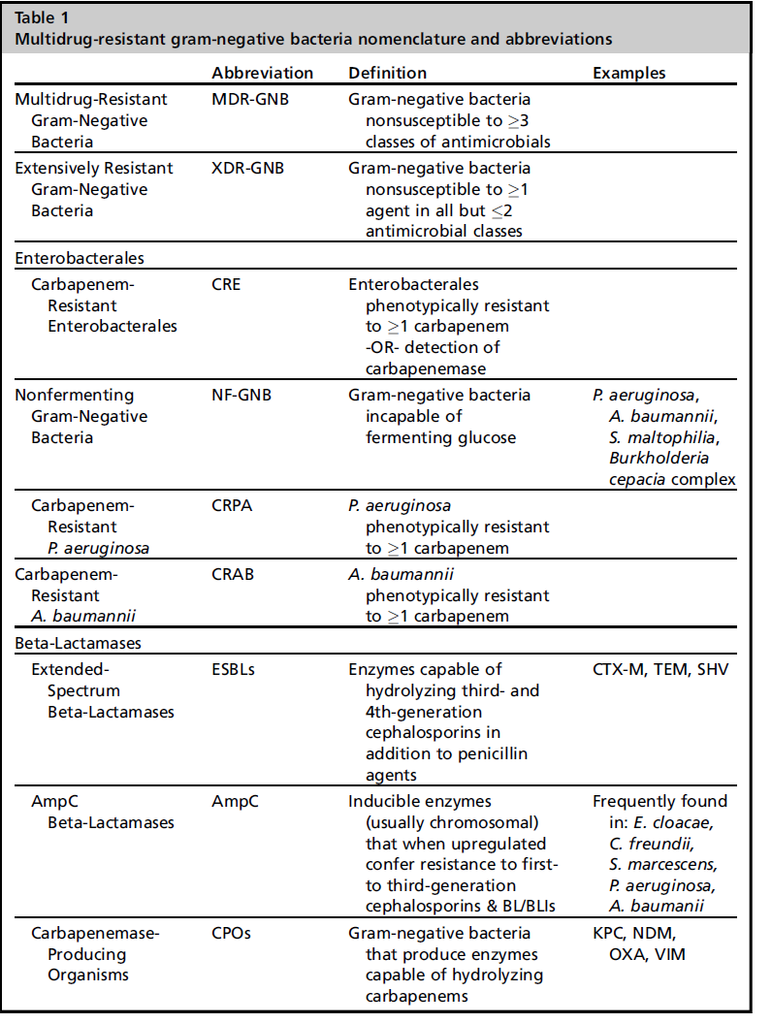
Nomenclature and Abbreviations

Slide 5
Comments in the AST table
IF reported as | Comment/Advice
S | “Susceptible” Clinically effective when used in standard therapeutic doses
I | “Intermediate” Clinically still effective when used with increased dose/frequency if the patients vital parameter permit. It also may indicate therapeutic efficacy in physiologically concentrated sites.
SDD | “Susceptible Dose Dependent” Indicate clinical trials have confirmed that it may be effective when used in increased dose/ frequency if the patients vital parameter permits
R | “Resistant” clinically ineffective when used in standard/increased therapeutic dose.

Slide 6
Definition of drug resistant bacteria
Multidrug resistant bacteria
Resistant to antibiotics more then two
of at least three different classes of
antimicrobial agents. ESBL/Ampc are MDR
Extensively drug resistant bacteria
Resistant to all antimicrobials except only one classes of antimicrobial agents (eg. Susceptible to colistin only)
Pan drug resistant bacteria
Resistance to antibiotics of all class of antimicrobial agents
Enterobacterials family
NDM-1,2(New Delhi metallo-betalactamase)
KPC(Klebsiella pnumoniae carbapenemase)
ESBL+Ampc
OXA-48
ESBL+porin Loss
Pseudomonas/ Acinetobacter:
MBL(Metalllo- beta lactamase like VIM, IMP,NDM etc)
OXA group
Efflux pumps
Ampc+ porin loss

Slide 7
Categories of ampc B lactamase resistance mechanisms
Inducible resistance
Non-inducible chromosomalresistance / stable chromosomal derepressions
Plasmid mediated resistance

Slide 8
Gram negative resistance
Predict antibiotic resistance mechanism from antibiotic susceptibility profile
BL/BLI combinations-What do they cover
Therapy for ESBL and AmpC producers
Therapy for carbapenem resistance bugs
Rationale for combination therapy
Enzyme involve in gm negative resistance
Non enzymatic mechanisms
Colistin resistance

Slide 9
Understanding the mechanism of resistance
Bacteria | E.coli | Klebsilella | pseudomonas | A. baumannii
Enzyme | NDM OXA48 | OXA48 NDM | VIM NDM IMP | OXA 23,24,51,58
Colistin resistance | 8% | 37% | <5% | <5%
Hyper virulence |  | +++

Slide 10
Resistance Mechanism-Pathogen grid
Pathogens | Beta Lactamase | Porin | Efflux
Enterobacterials | ESBL,KPC,OX48 | Omp F , Omp C mutation
Pseudomonas aeruginosa | AmpC | Opr D loses | MexAB-OprM
Acinotobacter spp | OXA 23 and 53

Slide 11
Predict antibiotic resistance mechanism from antibiotic susceptibility profile

Slide 12
Enzymes involved
Penicillin
Penicillinases
Amp C
Third generation cephalosporin
ESBLs
Carbapenamases:
KPC
NDM
OXA 48
OXA 23, 24, 51, 55
All cephalosporin's
Carbapenems

Slide 13
β-Lactamase

Slide 14
Enzymes does Class A contains
Group A ESBLs
TEM
SHV
CTXM
PER
VEB
GES
VES
Group A carbapenemase
KPCs
SME
IMI
GES

Slide 15
Class A enzymes | Inhibited by Tazobactum | Inhibited by Avibactum
CTXM | Uncertain | Yes
SHV | Yes | Yes
TEM | Yes | Yes
KPC | NO | Yes
PER/BEV (pseudomonas) | NO | Uncertain

Slide 16
Class D enzymes | Inhibited by Tazobactum | Inhibited by Avibactum
OXA 48-Klebsiella, Ecolli, Enterobactor | NO | Yes
Acinotobactor OXAs | NO | Unlikely
Pseudomonas OX As | NO | Unlikely

Slide 17
AmpC
Enterobactor | Susceptibility
Cefoxitin(Cephamycin) | R
Aztreonem | R
Carbapenems | S
Cefepime | S
Ceftazidime, Ceftriaxone | R

Slide 18
ESBLs
Antibiotics | Susceptibility
Cefoxitin(Cephamycin) | S
Aztreonem | R
Carbapenems | S
Cefepime | R
Ceftazidime, Ceftriaxone | R

Slide 19
Enterobactor | ESBL producer | AmpC producer | Remarks
Cefoxitin(Cephamycin) | S | R
Aztreonem | R | R
Carbapenems | S | S | Imipenam is a potent inducer
Cefepime | R | S
Avibactum | S | S | Cefta+Avbac

Slide 20
ESBLSs
Klebsiella | Susceptibility
Cefipime | R
Ceftriaxone | R
Meropenem | R
Aztreonem | R
Ceftazidime+ Avibactam | S

Slide 21
NDM
Klebsiella | Susceptibility
Cefipime | R
Ceftriaxone | R
Meropenem | R
Aztreonem | S
Ceftazidime+Avibactam | R

Slide 22
Predict best antibiotic from AST
Three step approach
Rule of Intrinsic resistance
Mechanism of resistance
Expert opinion for antibiotics

Slide 23
 | Antibacterial | Organism
1 | Ampicillin | Klebsiella, Proteus
2 | Cloxacillin | Enterocci
3 | Ceftriaxon(3GC) | Enterococci, L monocytogens, C Difficli
4 | Ceftazidime/cefixim/Ciprofloxacin | Staph
5 | Cefoperazone | GPC(Strep,Enterococci)
6 | Clindamycin | GNB, Enterococci
7 | Aminoglycoside | Facultative anaerobes, GPC, Staph
8 | Imipenem | Stenotrophomonas
9 | Itrapenem | Pseudomonas, Acinetobactor
10 | Carbapenems | MRSA, C Dif, Enterococci
11 | Colistin | Proteus, M morganii, Providencia, Serratia, Burkholderia, Salmonella, GPC and Anaerobes

Slide 24
Specimen or site where specific antibiotics are not to be reported
CSF | 1st &2nd generation CP, aminoglycoside Clindamycin Macrolides Tetracycline Fluroquinolones Carbapenems( Dori,imip, ertap)
Urine | Clindamycin Macrolide & Azithromycin Cloramphenicol Tigecycline
Blood | Tigecycline(Primary bacteraemia)
Respiratory specimen | Daptomycin Colistin(Systemic)

Slide 25
Black Box
Organisms/Group | CLSI 2019 |  | CLSI 2021
 | S | R | I | R
Enterobacterals |  |  | ≤2 | ≥4
Pseudomonas Aeroginosa | ≤2 | ≥4 | ≤2 | ≥4
Acinetobacter baumannii complex | ≤2 | ≥4 | ≤2 | ≥4
Acinetobacter other species
Non-Enterobacterals

Slide 26
CLSI and EUCAST for Colistin
Organisms/Group | CLSI 2021 |  |  | EUCAST 2021
 | S | I | R | S | R | ATU
Enterobacterals |  | ≤2 | ≥4 | ≤2 | >2
Pseudomonas Aeroginosa |  | ≤2 | ≥4 | ≤2 | >2 | 4
Pseudomonas species |  | - |  | ≤2 | >2 | 4
Acinetobacter baumannii complex |  | ≤2 | ≥4 | ≤2 | >2
Acinetobacter other species |  |  |  | ≤2 | >2

Slide 27
Specific organism-Antimicrobial agents related comments
Category | Organism | Antimicrobials | Result | Comments
VRE | Enterococcus | Vancomycin | R | Kindly ensure appropiate infection control measure
MRSA Vanc MIC>1 | Staphylococcus | Vancomycin | S | Therapeutic failure may encounter. Consider alternative drugs
Repeat Culture | -Pseudomonas Aerogenosa(allantimicrobials) - Staphylococcus species (Cipro & Levoflox) - Enterobacter, Klebsiella,Serratia(Ceftriaxon, Ceftazidime, Cefotaxime) |  | S | Risk of resistance during prolong therapy. So if patient not clinically improved within 3-4 days do repeat culture

Slide 28
Inducer+ labile substrates: 1/2GC,Cefoxitin,Cefotetan
Clavulanic Acid strongly induces cAmpC
Inducer+ Stable/ Unbreakable: Carbapenems
Weak inducers+Labile substrates : Ureidiopenicilins(pip),3GC,Aztreonam: Should not be used if proven to be cAmpC bugs
Weak inducer+ Stable/ unbreakable :Cefpirome & Cefipime(4GC):

Slide 29
Mechanism of Resistance
(R) Ceftazidime & most cephalosporin = ESBL
1. (R) to Cefoxitin but not Ceftazidime
inducable ampC producer
2. (R) Both Ceftazidime & Cefoxitin
de-repressed AmpC
2. (R) to Meropenam but not Imipenam Increased Eflux
(R) to imipenam > meropenam = loss of oprD porin

Slide 30
Antibiotic rule
Quinolone: (R) Moxi/Levo = (R) all Fluroquinolone
Aminoglycoside: (R) to 1 Amino = Does not affect other Amino
Beta lactum : (R) Ticar = (R) Pipera
(R) BL extends to their BL+BLI combination
(R) to 1 carba does not affect other carbapenems
(R) all BL including carba but (S) to aztreonam = MBL
-If metallo-betalactamase+ downgrade S I R maintain aztreonam S then downgrade(S I R) all the above group

Slide 31
AmpC beta-lactamase producing Enterobacterales?
•Amp C enzymes are class C serine beta-lactamases which hydrolyse penicillins, cephalosporins (except Cefepime), cephamycin and monobactam, antibiotics and are not inhibited by beta-lactamase inhibitors like clavulanic acid, tazobactam & sulbactam.
The major concern is on inducible chromosomal resistance as AmpC production occurs after exposure specific antibiotics, especially third generation cephalosporins. Hence, an Enterobacterale isolate that is initially susceptible to ceftriaxone/ ceftazidime may develop resistance to these agents after initiation of treatment resulting in treatment failure.
As Cefepime is the only cephalosporin that is stable against AmpC producers, it is the recommended treatment option when the cefepime MIC is ≤2 mcg/mL. When the cefepime MIC is ≥4 mcg/mL, Carbapenem is the recommended treatment option (as ESBL co-production may be present).
Fluoroquinolones, aminoglycosides, cotrimoxazole, tetracycline and other non-beta-lactam antibiotics do not induce AmpC and are also not substrates for AmpC hydrolysis. Hence these can also be considered whenever indicated.

Slide 32
Organism have an inducible Ampc?
SPICE
Serratia
Pseudomonas
Proteus , morganella
Citrobactor
Enterobactor

Slide 33
New agent for treatment MDR-GNB
 | FDA/EMA approved | EUCAST Breakpoint
 |  |  | ESBL | AmpC | OXA 48 | KPC | MBL
Ceftolozane-Tazobactam | yes | yes
Ceftazidime-avibactam | yes | yes
Imipenam-relebactam | yes | yes
Meropenam-vaborbactam | yes | yes
Aztreonam-ceftaz/avibactam | No | No
Cefiderocol | yes | yes
Eravacycline | yes | yes
CMI sept 2017

Slide 34
NDM/IMP/VIM
 | Antibiotics
1st line | Cefiderocol
2nd line | Ceftazidime/avibactam+Aztreonam+a third agent based on sensitivities
3rd line | Combination therapy according to sensivities: Ciprofloxacin/tigecycline(Not pneumonia)/Fosfomycin IV/Co-trimoxazole/ Aminoglycosides
4th line | Combination therapy as above but including :Colistin

Slide 35
Pan resistance- Is not a Death Warrants

Slide 36
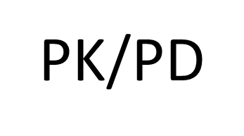
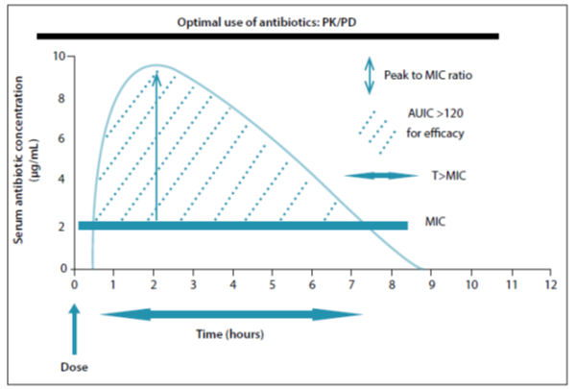
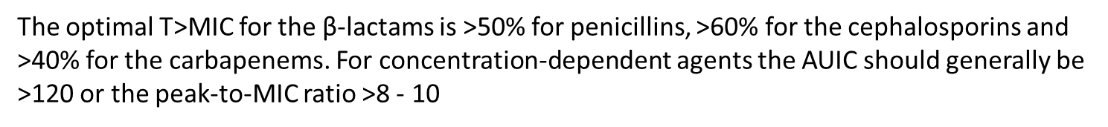
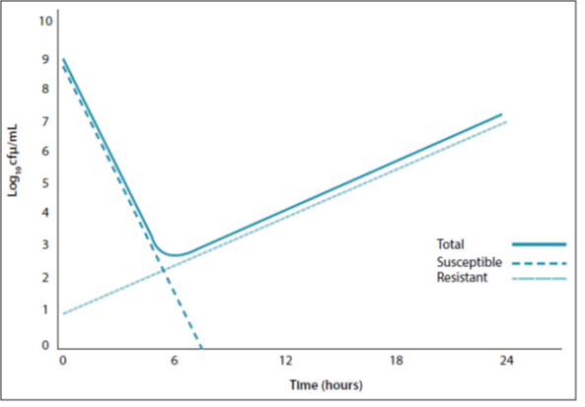
The concept of MPC and
potential pitfalls of MIC-based dosing
The concentrations should be >4 times the MIC for specific periods to prevent selection of resistant organisms

Slide 37
Aminoglycosides
In general, amino glycosides are administered for short periods as empirical therapy to decrease the likelihood of inappropriate therapy for hospital-acquired infections.
Hydrophilic agents where the Vd is increased and in the presence of ARC, concentrations may be suboptimal. Amikacin 15 mg/kg, for example, did not reach effective concentrations, with MICs of 8 mg/L, and it is possible that inconsistent concentrations
Some reviewers have suggested that doses as high as 25 - 30 mg/kg .

Slide 38
Colistin
Colistin is a last-line drug and if used inappropriately resistance will develop rapidly. Which makes a bolus dose necessary to achieve therapeutic effect.
It is effective against most Gram-negative bacilli, except Proteus spp., B. cepacia, Providencia spp., Serratia marcescens and Morganella spp.
Colistin is not administered as monotherapy and options include the carbapenems (provided the MIC is ≤32 mg/L (for carbapenem-resistant Enterobacteriaceae), tigecycline (Acinetobacter),fluoroquinolones, rifampicin and others, even if the organism is resistant to these drugs.

Slide 39
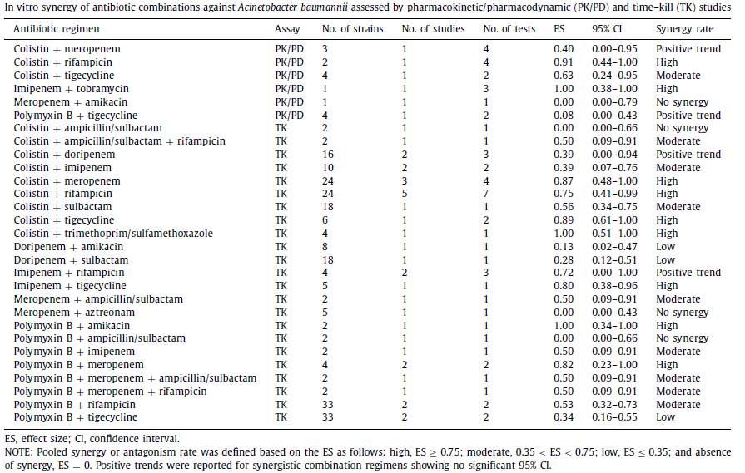
Synergistic Combination

Slide 40
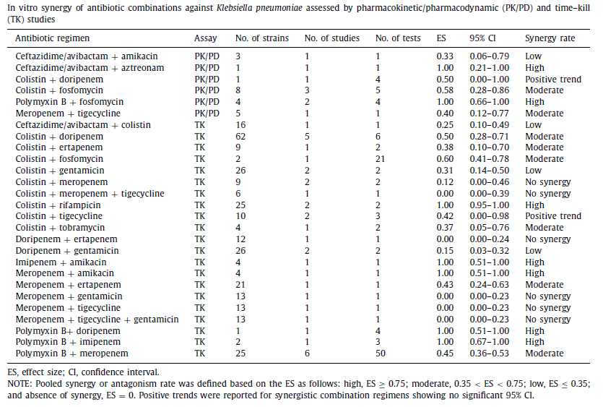

Slide 41
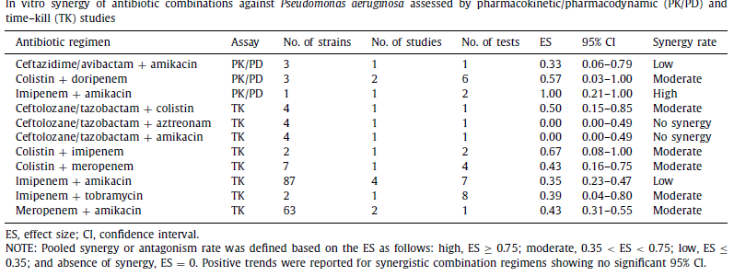

Slide 42
Combination
Indications
Severe sepsis and septic shock
Endocarditis
Bacteremias in certain high-risk host
Infection with risk resistant pathogens
High morbidity or mortality
Risk of emergent resistance is high
Infection initially fails or slow to respond to single active agent
Empirically pending susceptibility results
Guidance documents or reviews not pharma –funded
Target dugs
- Colistin-Fosfomycin-Tigecycline
-Carbapenems-Aminoglycosides
-Ceftazidime-abivactam-Aztreonam

Slide 44
Which are the most effective Abx in your AST report?
MIC breakpoint/MIC ratio (C/MIC index)=BMQ (Most effective & practical)
Antibiotic | Susceptible | MIC | CLSI breakpoint
Amikacin | S | 8 | <16
Tigecycline | R | 4 | <2
Meropenem | R | 64 | 2
Fosfomycin | R | 32 | 32
Colistin | R | 4 | 2
Aztreonam | R

Slide 45
Considerations
What Antibiotics to Use?
Organism
Availability
Affordability/ Patients acceptance
Hospital Antibiotics Susceptibility/Resistance data

Slide 46
Features to be considered in selecting antibiotics
 | Strong inducer | Weak inducers
Good substrate (susceptable to hydrolysis) | Aminopenicillins, 1st generation cephalosporins, cephamycins(cefoxitin, cefotetan) | Ceftazidime, Ceftriaxone, cefotaxime, pipercillin, ticarcillin, aztreonam
Poor substrate | Imipenem | Cefepime
 | Ertapenem, meropenem

Slide 47
Role of Cefepime
> Organism with moderate /high risk of significant Ampc production with cefipime MIC<2 mch/ml
MIC> 4 mcg/ml (if S to carbapenem)- carbapenem
Reserve for organism exhibiting carbepenem resistance
Ceftazidime-avibactam
Cefiderocol

Slide 48
Exercise and Discussion

Slide 49
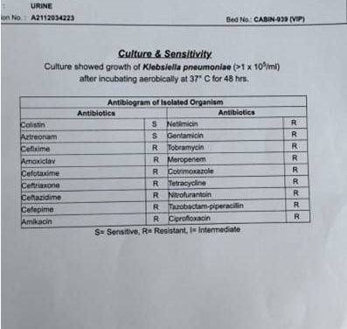
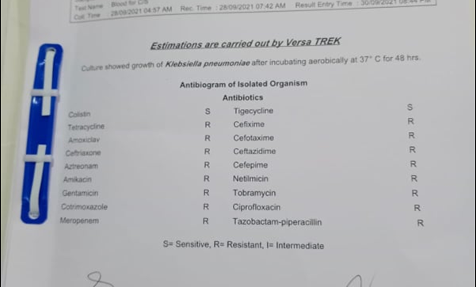

Slide 50
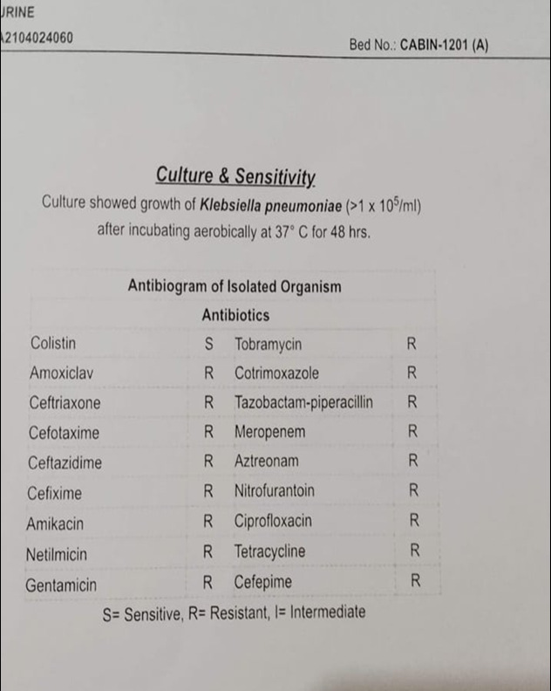
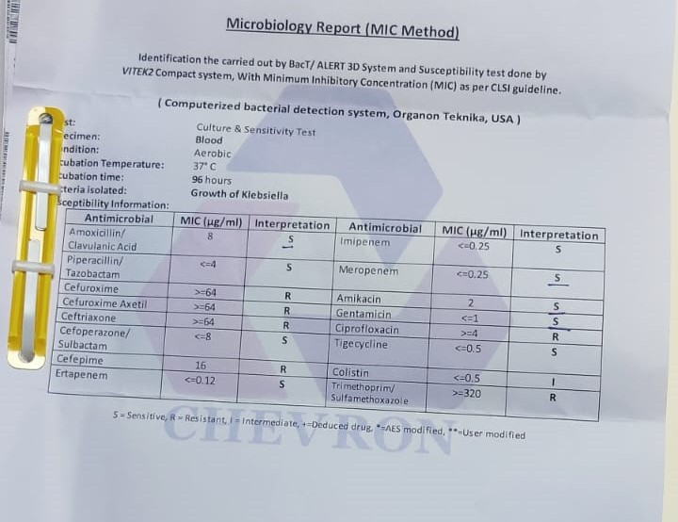

Slide 51
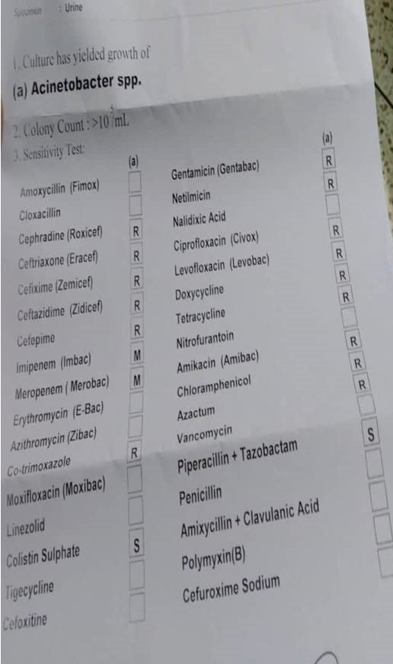

Slide 52
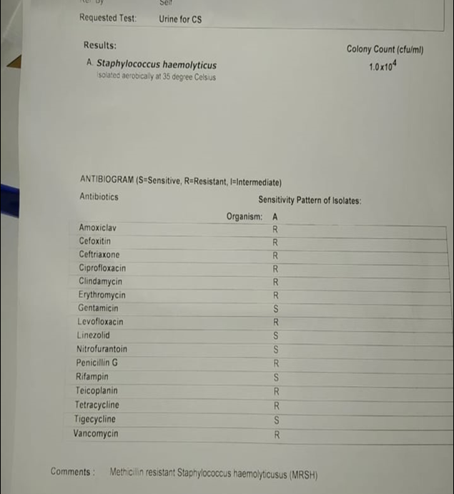
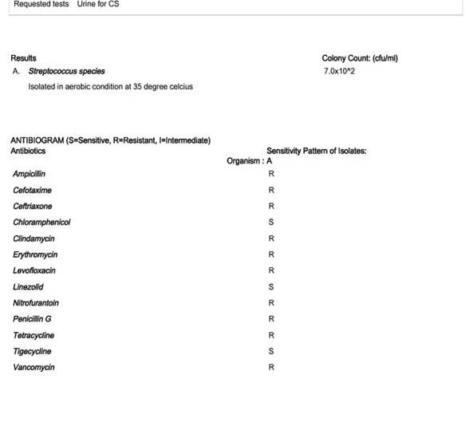

Slide 53
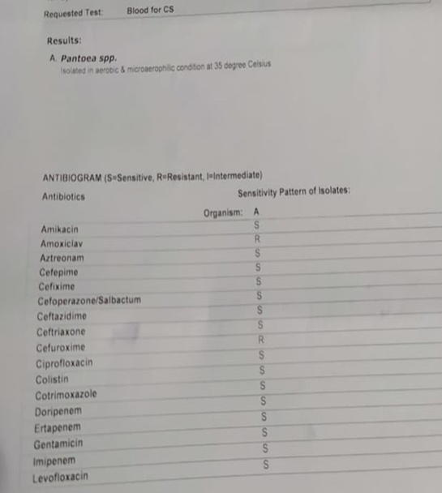
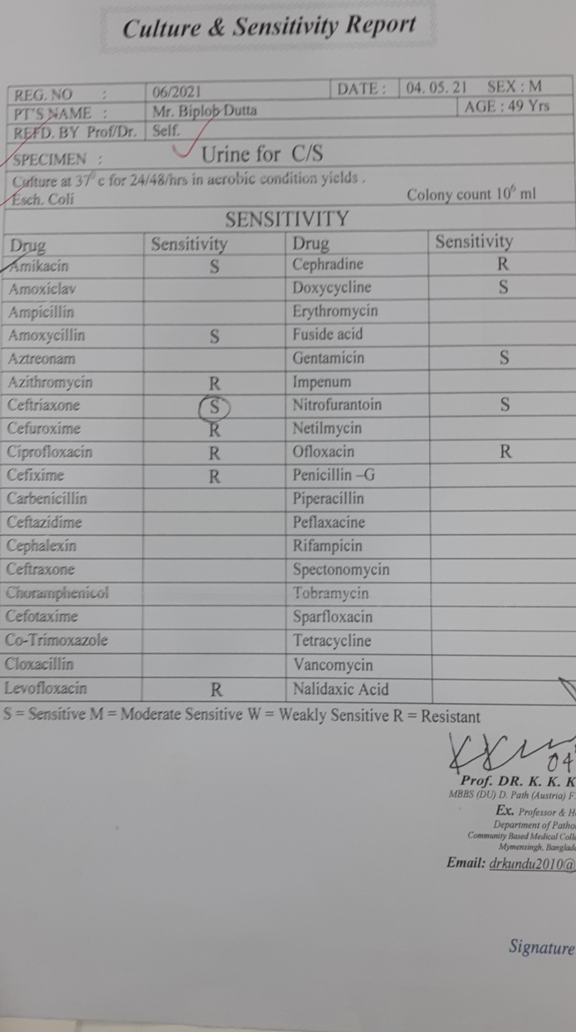

Slide 54
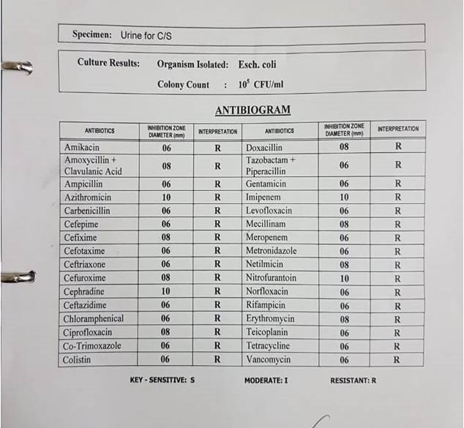
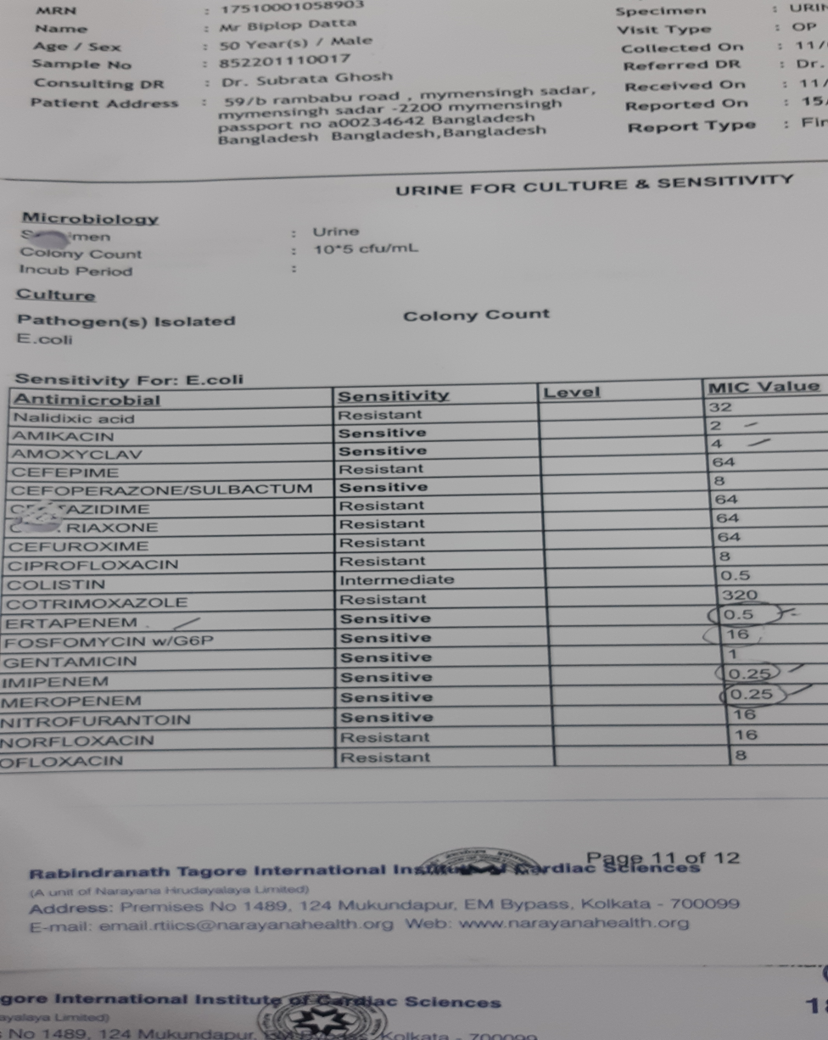

Slide 55
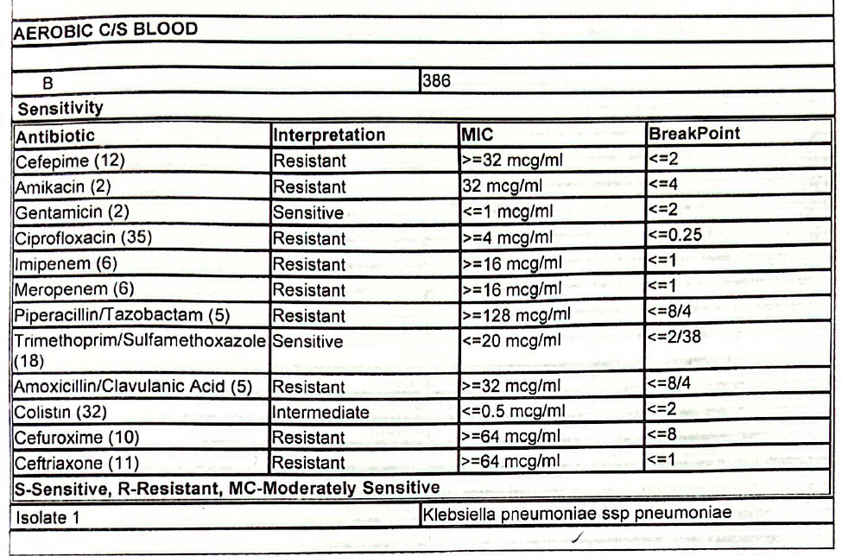

Slide 56
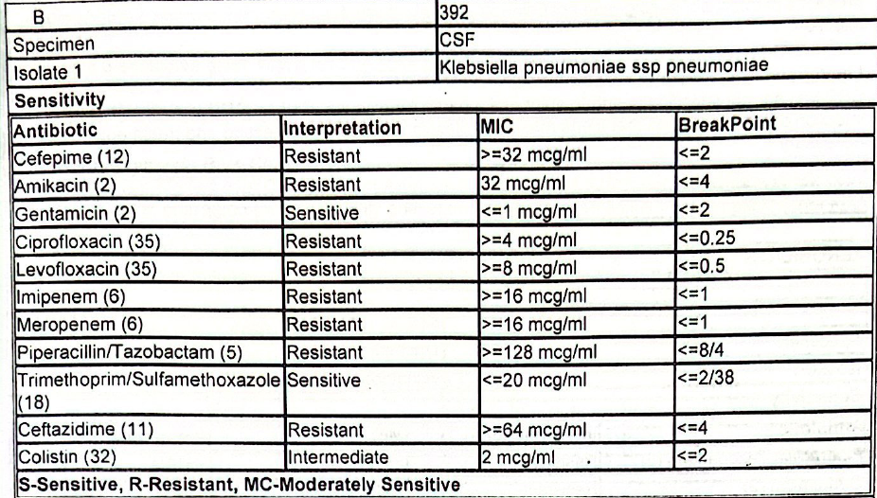

Slide 57
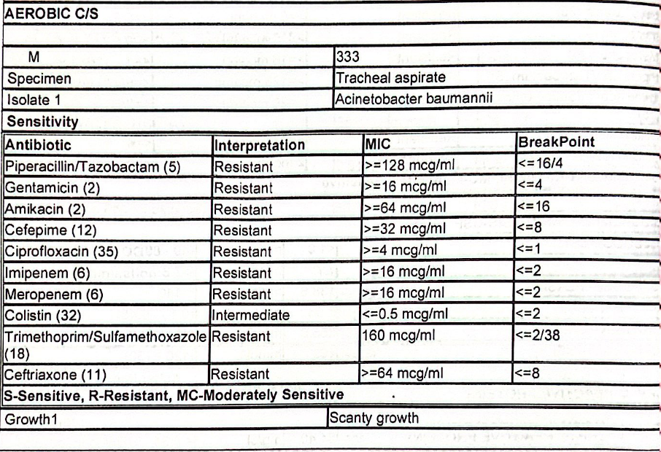

Slide 58
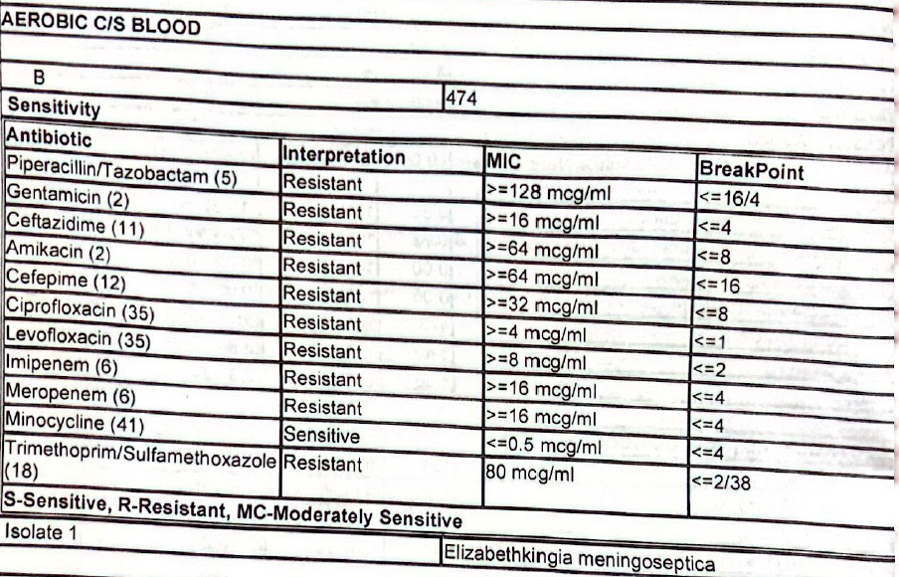

Slide 59
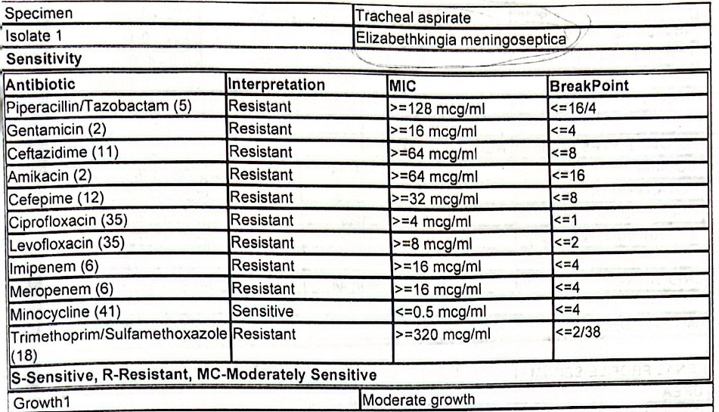

Slide 60
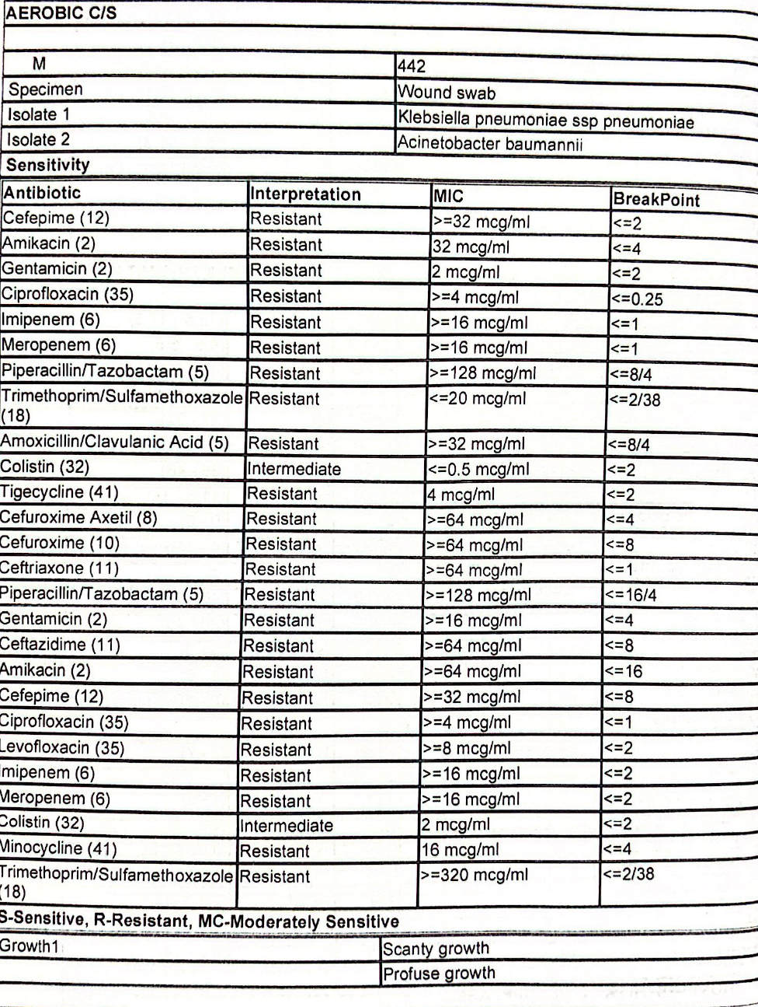

Slide 61
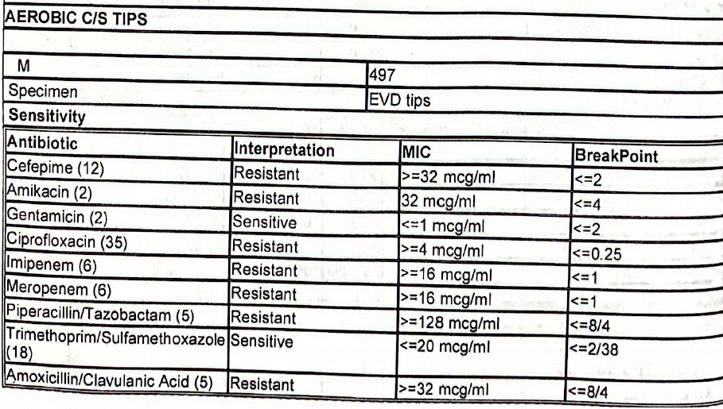
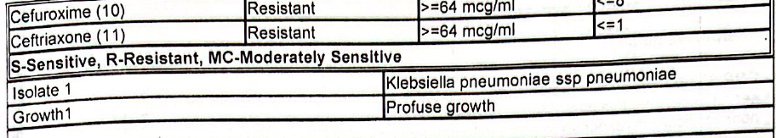

Slide 62
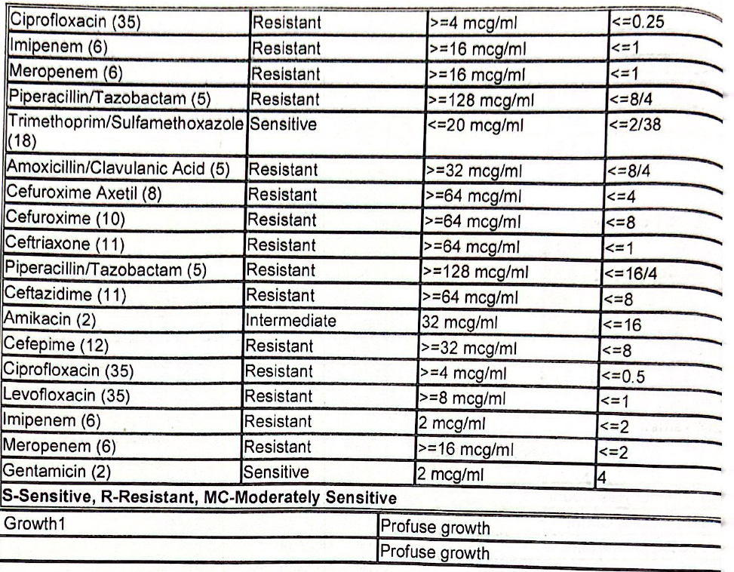
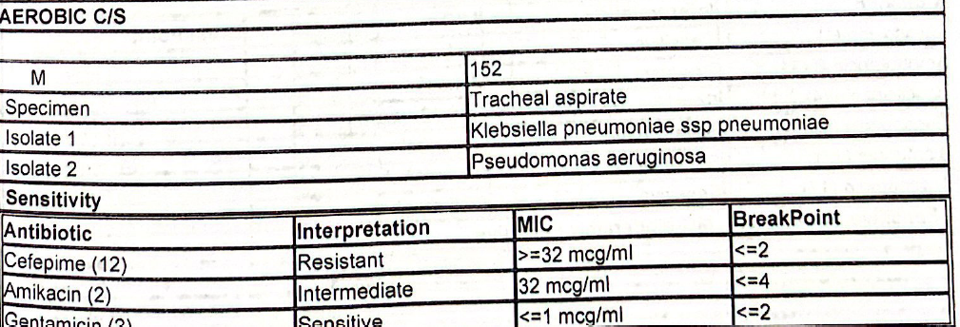

Slide 63
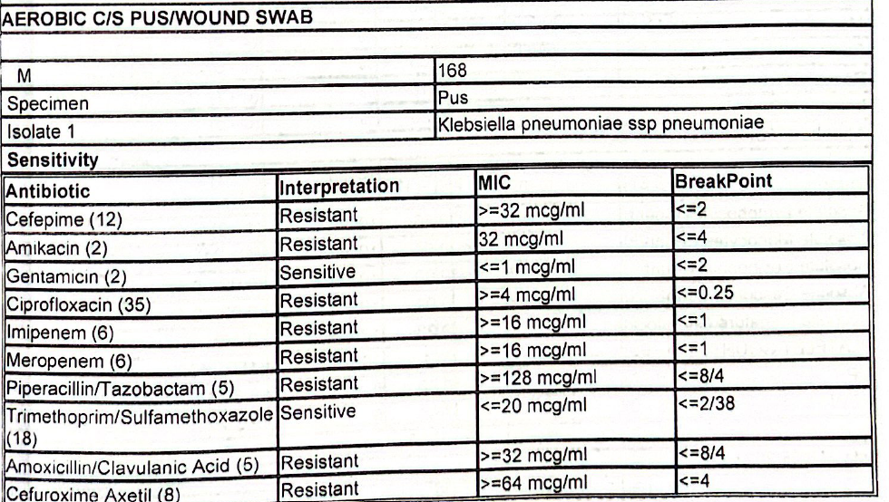

Slide 64
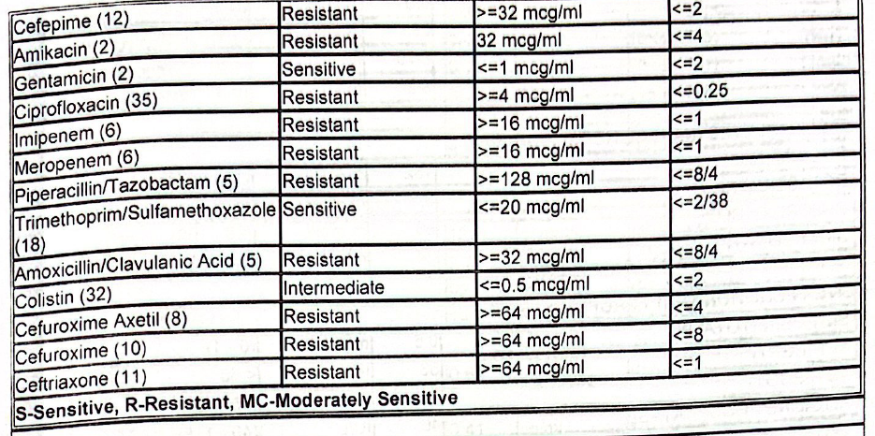
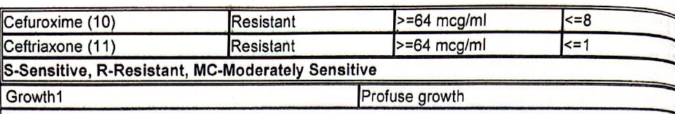

Slide 65
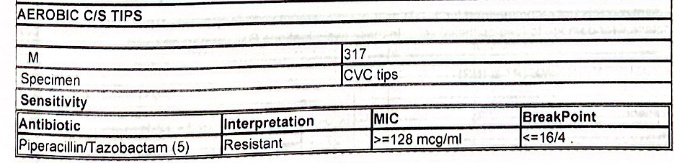
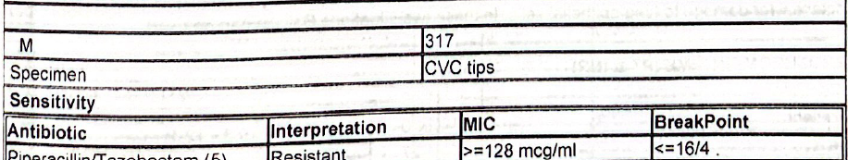
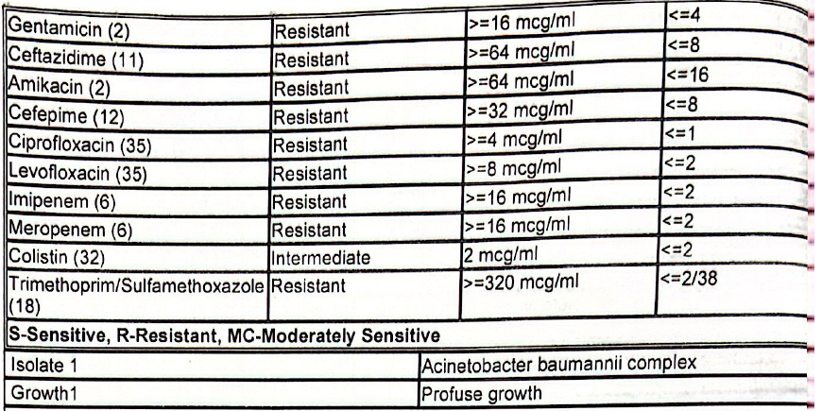

Slide 66
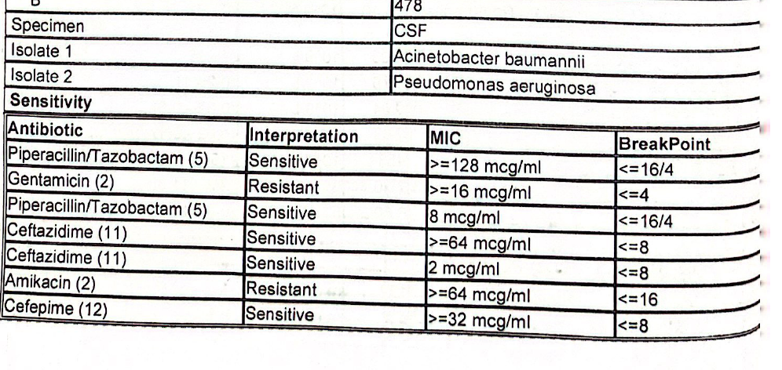
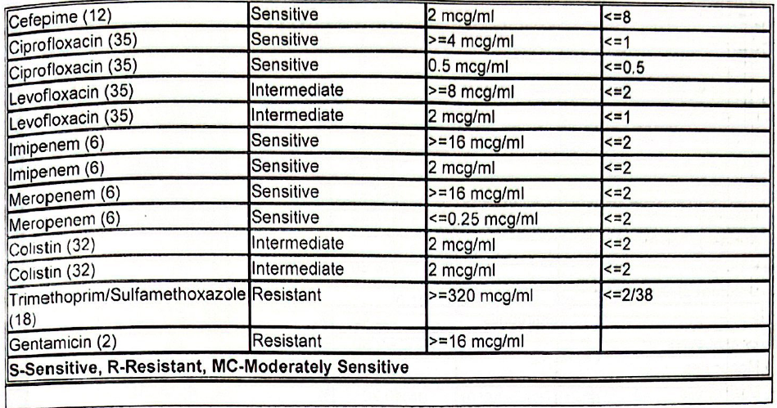

Slide 67
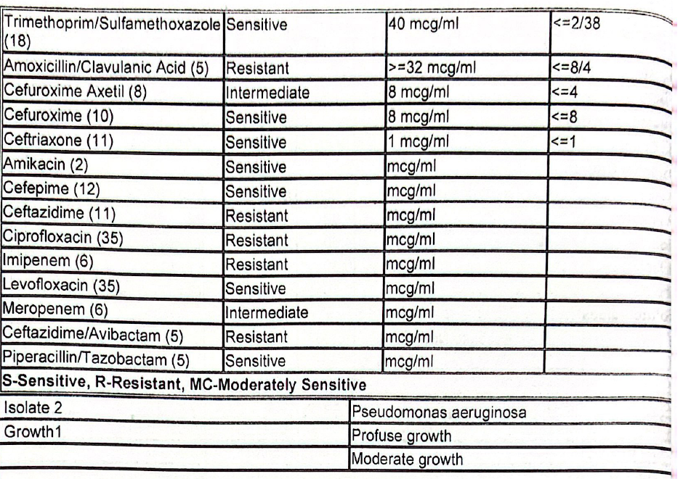
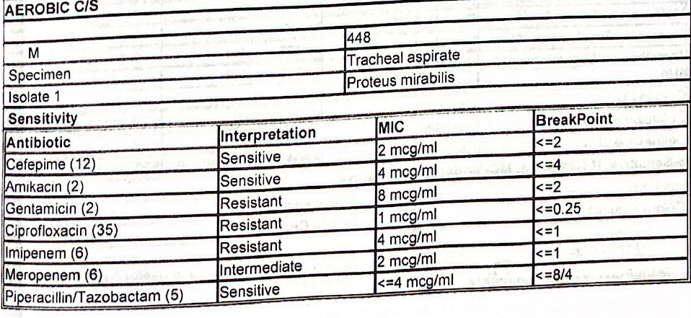

Slide 68
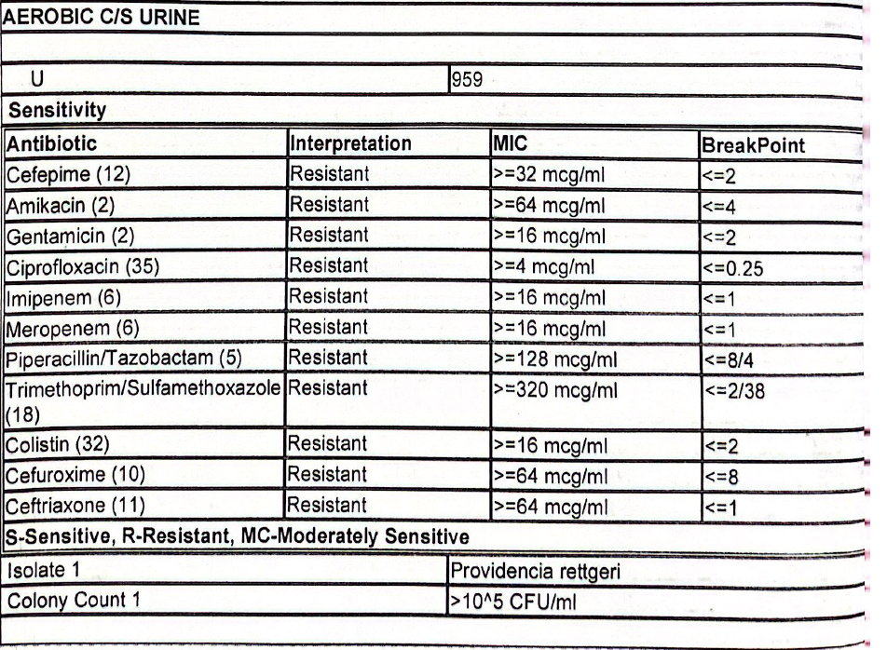

Slide 69
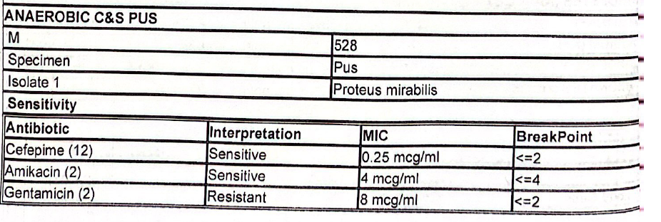
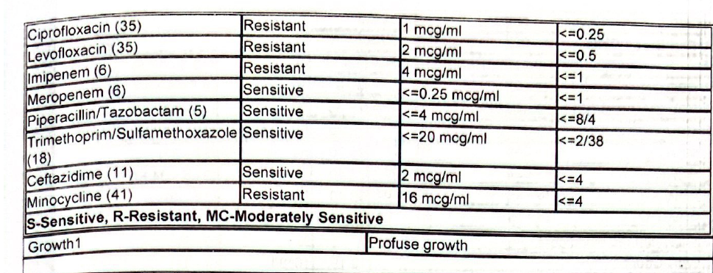

Slide 70
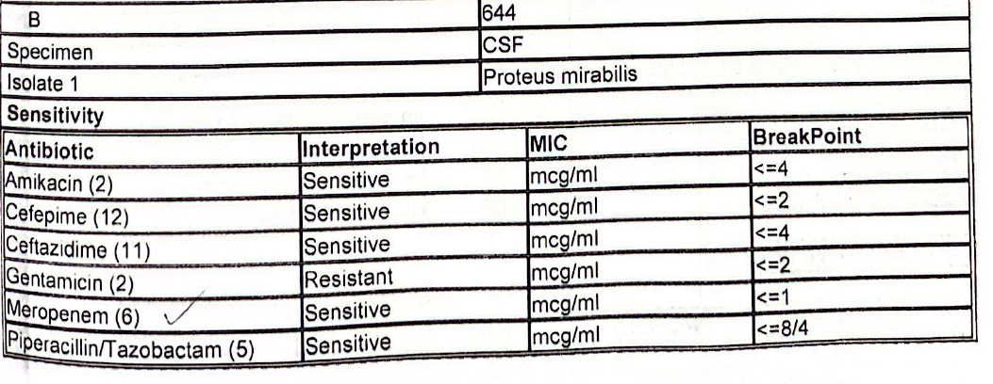

Slide 71
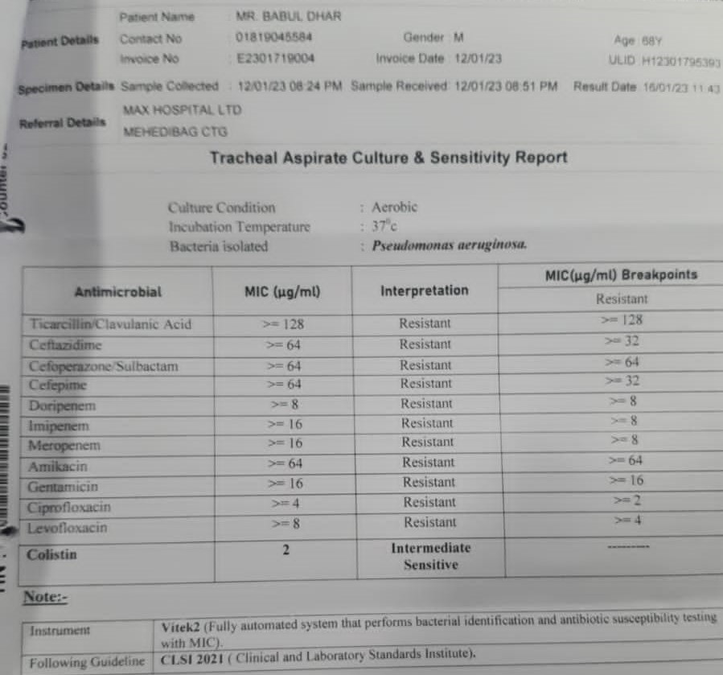

Slide 72
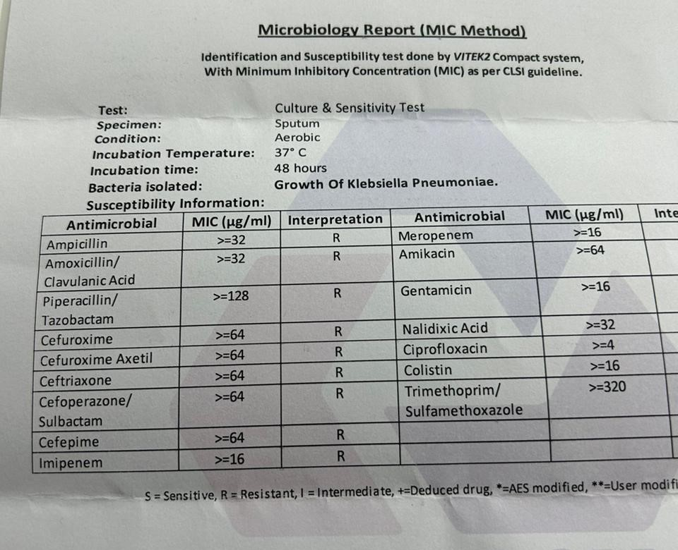

Slide 73
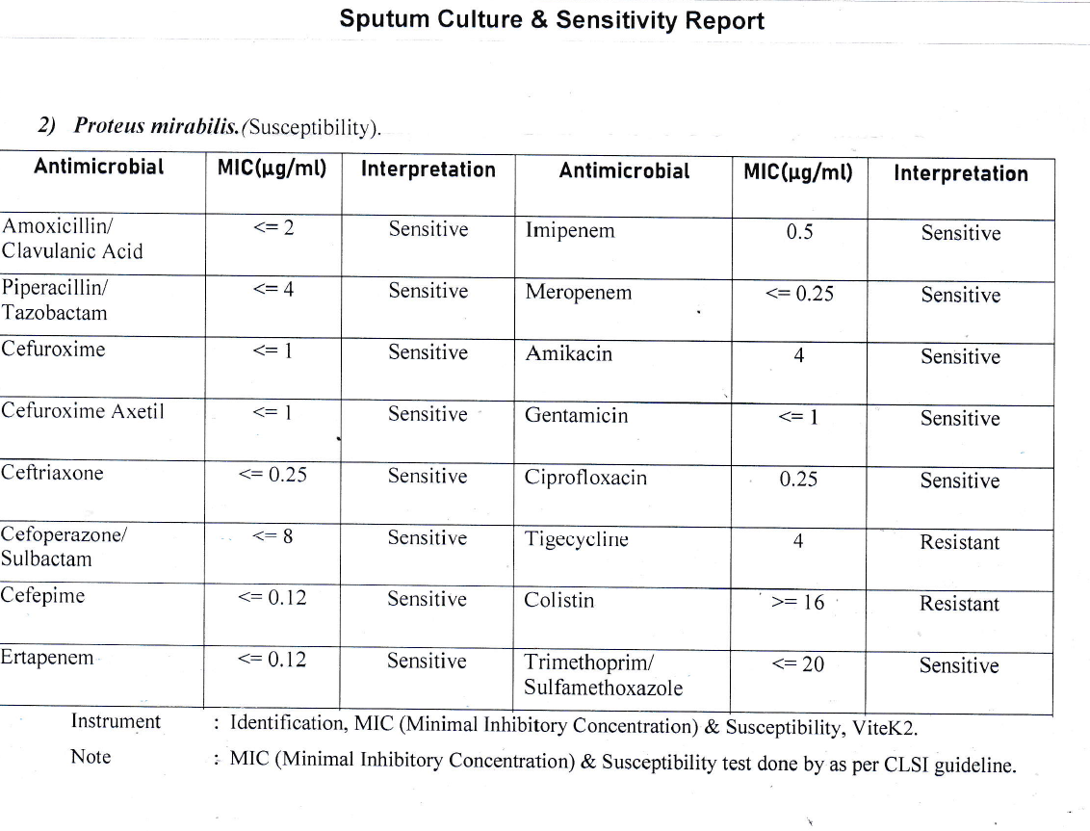

Slide 75
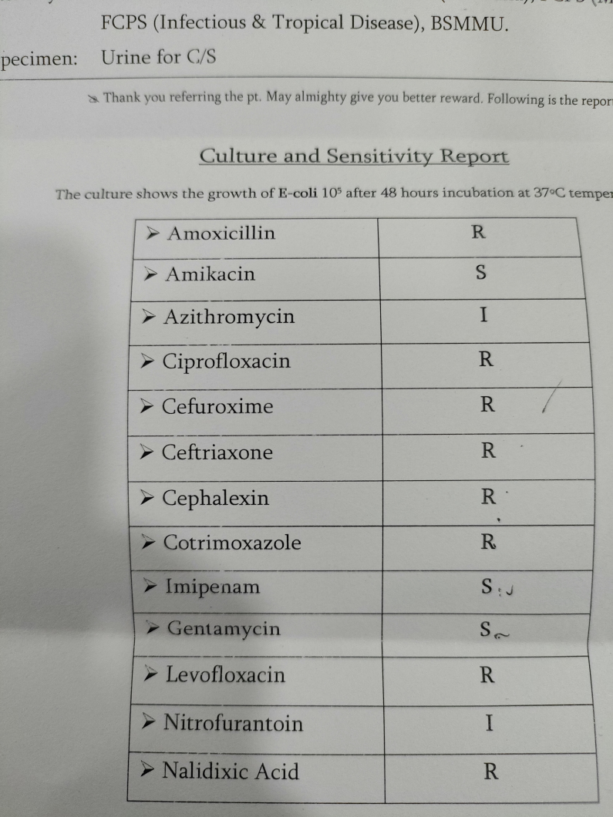
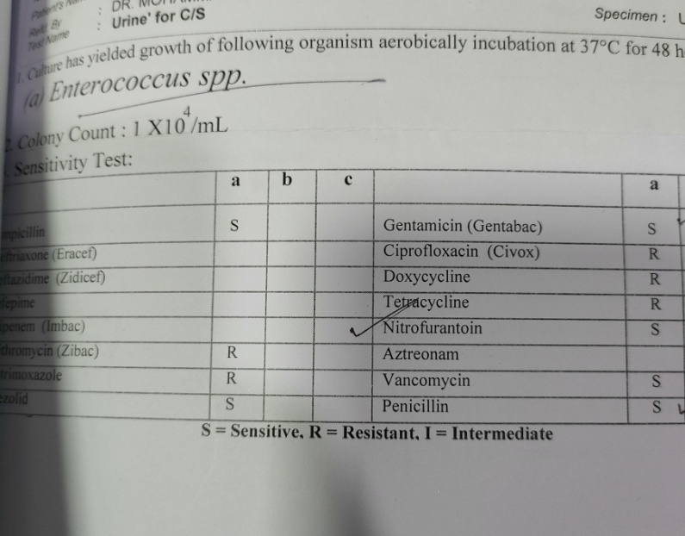

Slide 76
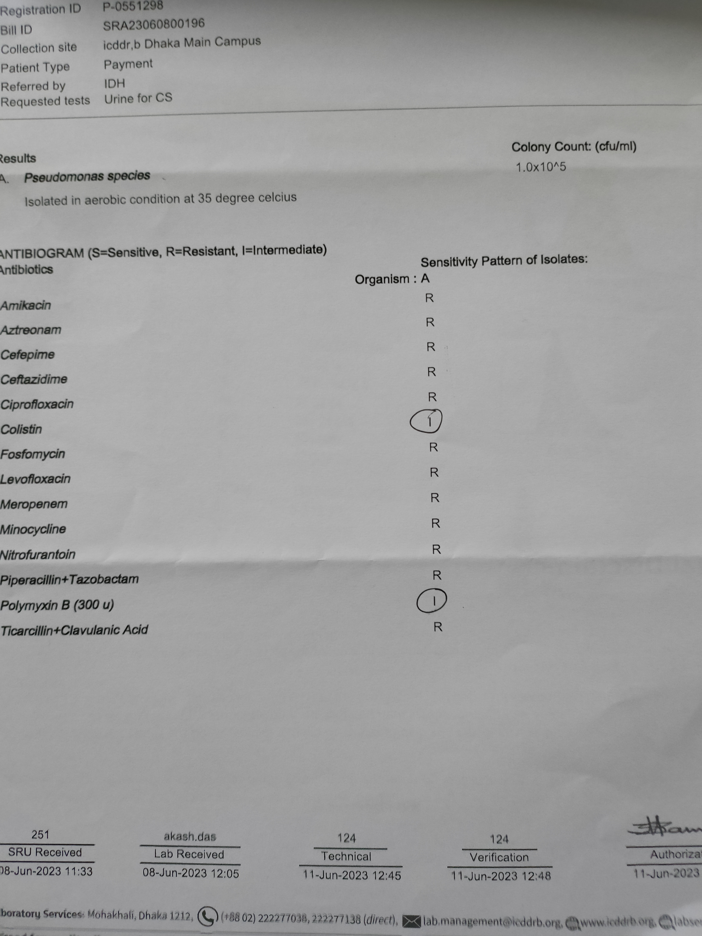

Slide 77
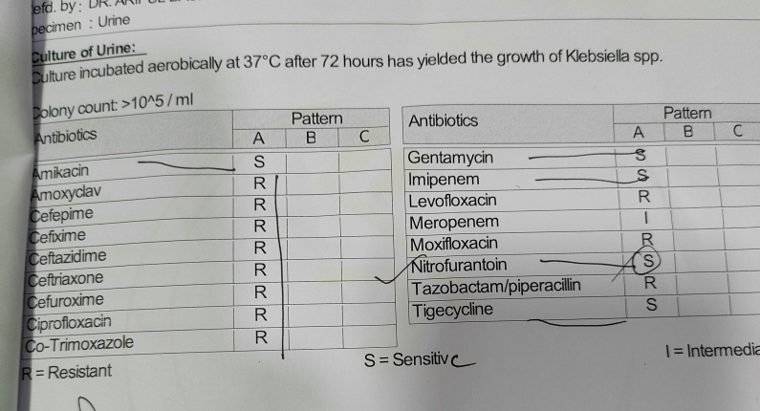

Slide 78



Slide 79
Medicine is a science of uncertainty and an art of probability
William Osler
Prescribe wisely

Slide 80
Black Box
Organisms/Group | CLSI 2019 |  | CLSI 2021
 | S | R | I | R
Enterobacterals |  |  | ≤2 | ≥4
Pseudomonas Aeroginosa | ≤2 | ≥4 | ≤2 | ≥4
Acinetobacter baumannii complex | ≤2 | ≥4 | ≤2 | ≥4
Acinetobacter other species
Non-Enterobacterals

Slide 81
CLSI and EUCAST for Colistin
Organisms/Group | CLSI 2021 |  |  | EUCAST 2021
 | S | I | R | S | R | ATU
Enterobacterals |  | ≤2 | ≥4 | ≤2 | >2
Pseudomonas Aeroginosa |  | ≤2 | ≥4 | ≤2 | >2 | 4
Pseudomonas species |  | - |  | ≤2 | >2 | 4
Acinetobacter baumannii complex |  | ≤2 | ≥4 | ≤2 | >2
Acinetobacter other species |  |  |  | ≤2 | >2

Slide 82
Specific organism-Antimicrobial agents related comments
Category | Organism | Antimicrobials | Result | Comments
VRE | Enterococcus | Vancomycin | R | Kindly ensure appropiate infection control measure
MRSA Vanc MIC>1 | Staphylococcus | Vancomycin | S | Therapeutic failure may encounter. Consider alternative drugs
Repeat Culture | -Pseudomonas Aerogenosa(allantimicrobials) - Staphylococcus species (Cipro & Levoflox) - Enterobacter, Klebsiella,Serratia(Ceftriaxon, Ceftazidime, Cefotaxime) |  | S | Risk of resistance during prolong therapy. So if patient not clinically improved within 3-4 days do repeat culture

